Slide 1
Infiltration: 2332
Noun
Tyler Do, Mark Belyak, Alex Tang, Raghu Tirumala

Slide 2
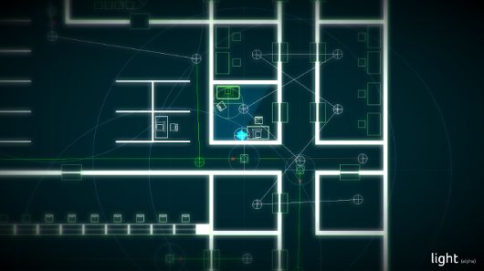
Game Style
Puzzle/Action/Stealth
Top-down 2D
Player traverses through obstacles and enemies

Slide 3
Storyline
Takes place in the 24th century
The main hero is a cyborg space Uber driver
During bring your daughter to work day he gets raided by space pirates, who knock him out and takes his daughter
After he wakes up he realizes his daughter is missing. He realizes he needs to save her
After weeks of training he tracks the space pirates and infiltrates their fortress

Slide 4
Winning and Losing
Losing:
Guard touching you
Getting caught in a trap
Running out of time on the last level
If you lose you have the option to restart the level
You beat every level by reaching the end. This takes you to the next level. You finish the game when you rescue your daughter in the last level

Slide 5
Gameplay
Player can deploy a cyborg spider to help them traverse the level
Some doors will require key cards that the player can find on the level
Doors must be unlocked to pass areas of the level

Slide 6
Obstacles
Hazards:
Trap door
Laser grid (blinks)
Enemies:
Patrol guard (chases)
Bounty hunter (faster, shoot tranq dart)
Cameras: have line of sight, rotates
Alarm: puts guards on alert state (guards speed up)

Slide 7
Cyborg Spider
Capabilities:
Unlock doors
Disable cameras and alarms
Distract guards
Limited spiders per level
Bug must be picked back up and recharged after use
Spider is squished upon contact with guard

Slide 8
Objective
Goal: your overall goal is to save your daughter from the space pirates
-1st level: Basic level introducing mechanics, almost like a tutorial. You end up in a storage room where you find a cyborg spider that you can control. Messages teach you the different things it can interact with, such as doors, guards and cameras.
-2nd level: More difficult than the first level, more freedom to complete it the way that you want to. In the end you rescue your daughter but you trigger an alarm -Final level: Includes the core mechanics of the game, but when you get to your daughter you have to escort her out with you. There is a time limit

Slide 9

Achievements
Clearing level without being detected
Clearing level in x amount of time
Clearing the game
Clearing level without using cyborg spider

Slide 10
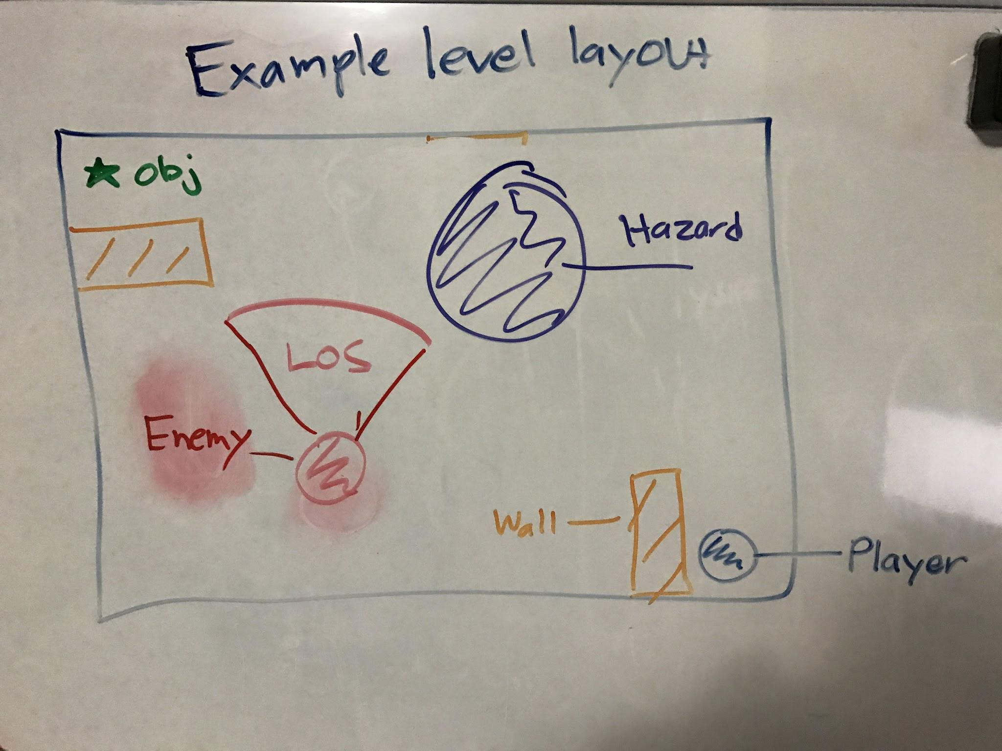
Example Level

Slide 11
Prototypes
Cyborg Bug
Unlocking doors
Disabling cameras and alarms
Distracting guards
Guards
Patrolling
Chasing
Line of sight

Slide 12
Expected Difficulties
Line of sight mechanics
Cyborg spider mechanics
Chasing mechanics
Art in general

